Slide 1

RENTAL ANALYSIS
ON DIFFERENT LOCATIONS

Slide 2
INTRODUCTION
The main aim of the project is to analysing the rental data and gaining insights and which factors influence the price of property.
For this we have scraped data from “MAGICBRICKS” a website which contains about rentals , we have scraped data from locations : Chennai , Mumbai , Hyderabad, Bangalore and Kolkata
We have scraped data by using Selenium and Beautiful Soup and REGEX.

Slide 3
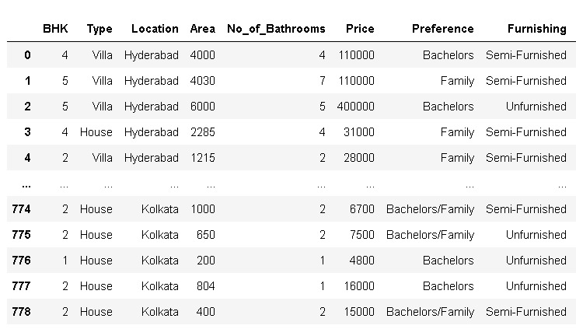
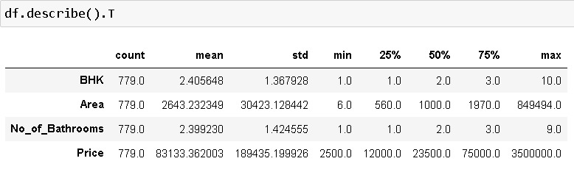

Slide 4
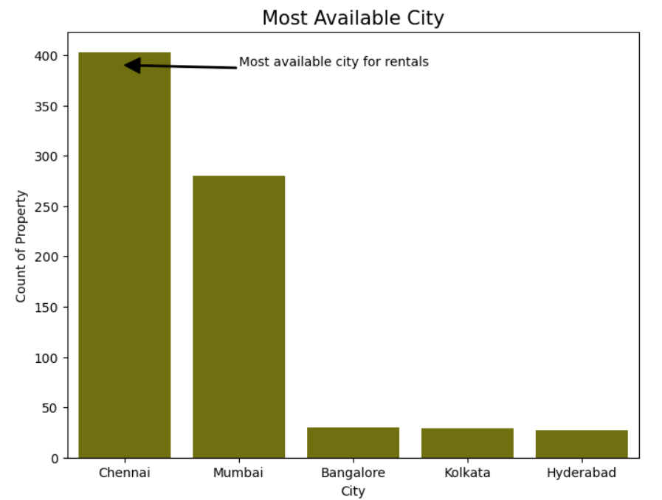
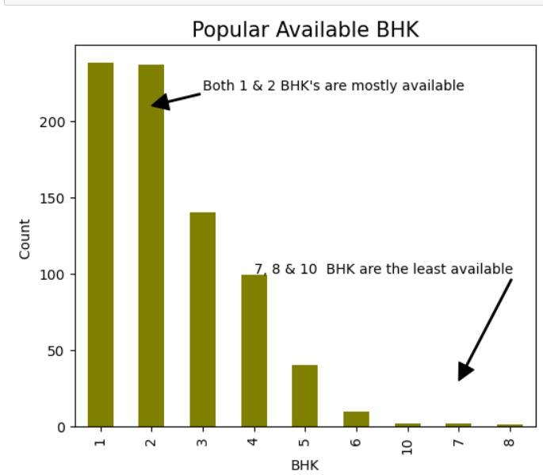
Which city have more availability for rentals ?
INSIGHT:
By this above visual the city Chennai has more number of properties available for people to rent
Which is the most available BHK?
INSIGHT:
Most of houses available are 1&2 BHK's for rentals and 7,8 and 10 BHK's are least ones

Slide 5
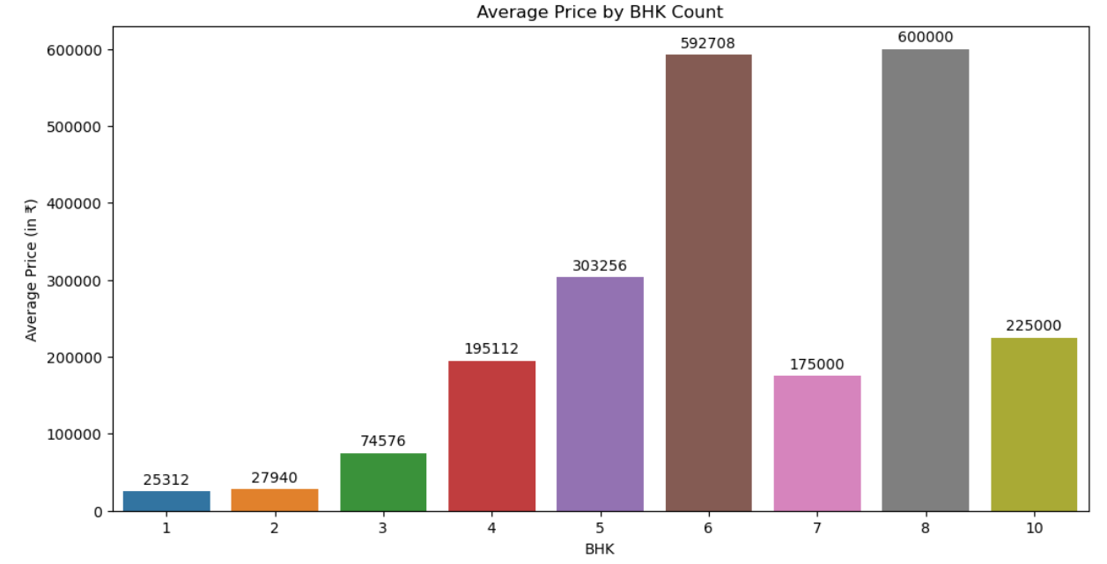
What is the average price based on types of BHK?
INSIGHT:
8BHK have highest average price of 6L . The reason behind that the availability of 8BHK is less when compared to other BHK's

Slide 6
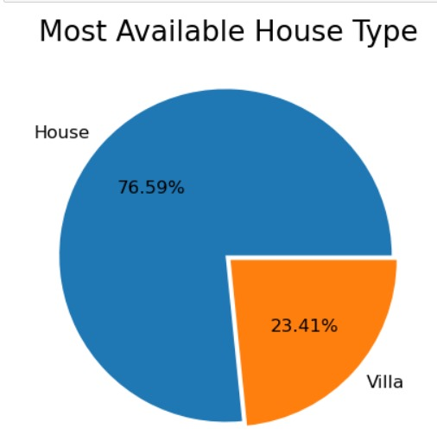
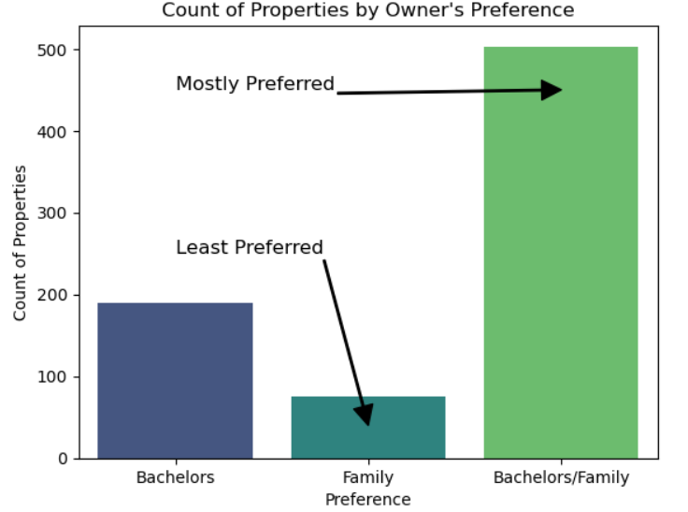
Which type of House is most available?
INSIGHT:
Most of the available properties are houses rather than villas because house can be available at cheaper price when compared to villa.
ON WHICH CATEGORY OF PEOPLE , OWNERS ARE INTEREST TO GIVE RENTALS?
INSIGHT:
Most of the owners prefer to give rentals for family or for bachelor's .But some of the owners have restrictions to give only rent to only for bachelor's or for only Families

Slide 7
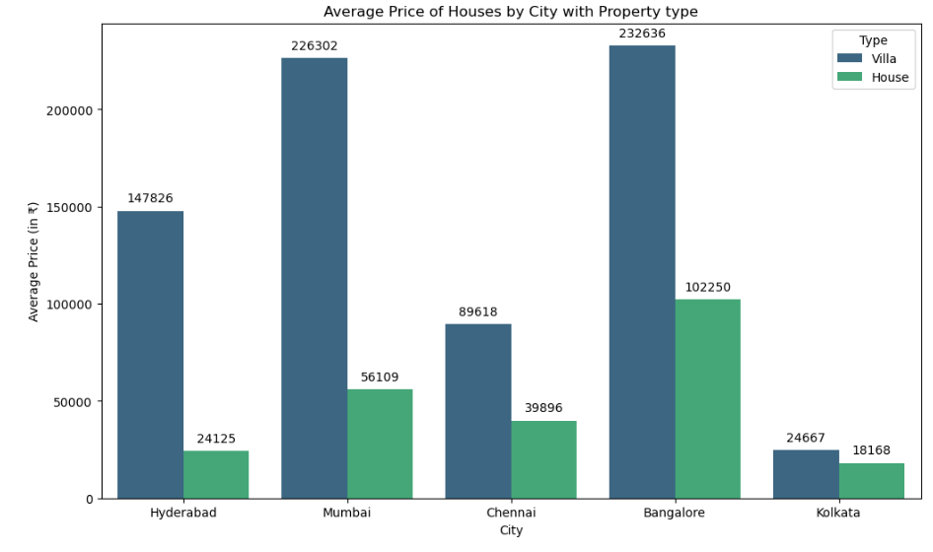
What is the average price in different locations based on property type?
INSIGHT:
Villa's has more average price in different locations . The main reason for that is Villa's have more luxurious infrastructure when compared to houses.

Slide 8
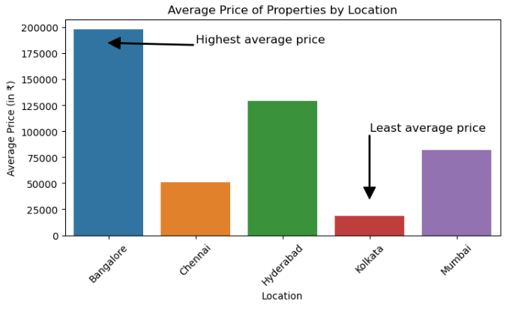
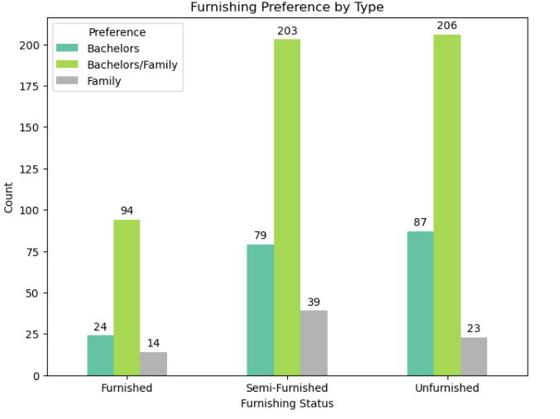
WHAT IS THE AVERAGE PRICE OF PROPERTY BASED ON LOCATION?
INSIGHT:
Bangalore has highest average price due to rapid population growth driven by job opportunities in the IT sector, leading to high demand for housing and Kolkata has least average price because when compared to remaining cities , Kolkata has a slower rate of economic growth and industrial expansion.
WHAT IS THE FURNISHED TYPE AVAILABLE FOR THE DIFFERENT CATEGORY OF PEOPLE?
INSIGHT:
Unfurnished and semi furnished houses are mostly available for family/ bachelor’s .The main reason may be the fully furnished are more expensive that can’t be afford by them.

Slide 9
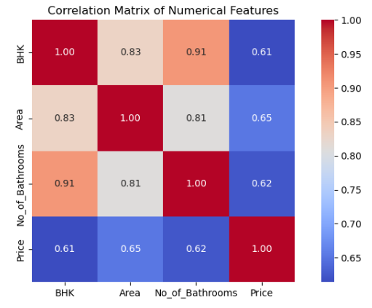
How the numerical columns are correlated?
INSIGHT:
Properties with more BHKs (Bedrooms, Halls, Kitchens) tend to have more bathrooms (correlation of 0.90).
Properties with more BHKs also tend to be more expensive (correlation of 0.47).
There is a moderate correlation between the number of bathrooms and the price (0.49).
The area of the property does not significantly affect the number of BHKs, number of bathrooms, or the price.

Slide 10
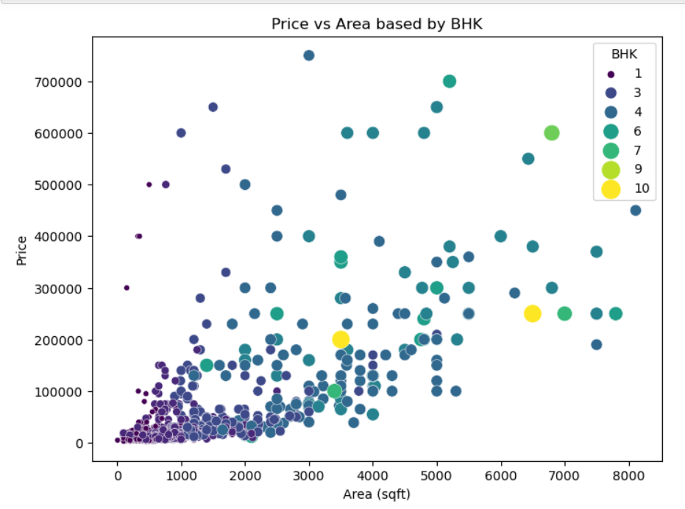
Relationship between price and area with respective bhk
INSIGHT:
Properties with larger areas generally have higher prices.
Higher BHK properties (more bedrooms) are larger and more expensive.

Slide 11
CONCLUSION
Bangalore has the average price. Kolkata has least average price.
Based on different locations price differ. Bachelor’s/Families can get property for rent easily. Less owner’s have restrictions for giving only to bachelor’s and familes
With the increase of Area ,BHK the price gradually increases
Most of the available property type is houses because only few will have the capacity to accommodate Villa’s.

Slide 12


